Slide 1

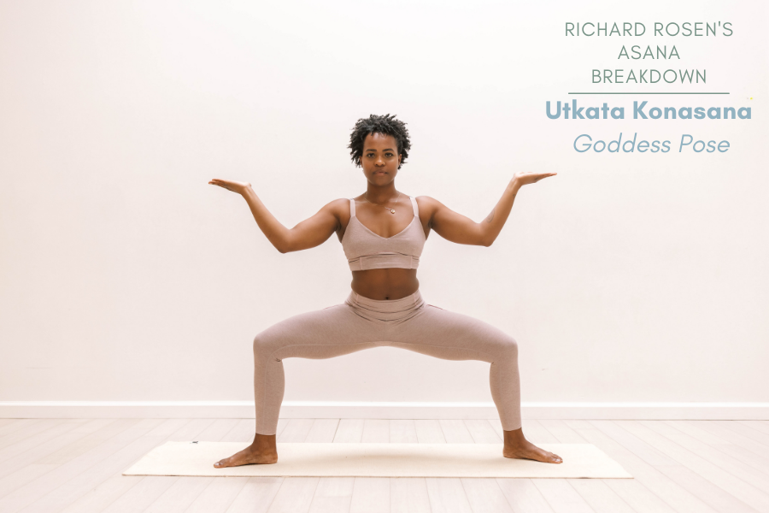
LIVE YOGA POSE DETECTION.
A Computer Vison Project.
UNDER GUIDANCE OF
Ms Meenakshi Maindola
By : Tanmay Pandey
Roll Number : 2021498
Student ID : 22021852

Slide 2
What is Yoga Pose Detection System and Its need?
Introduction: A Yoga Pose Detection System is needed to help individuals practice yoga more effectively by providing instant feedback on their poses, ensuring proper form and alignment.
A Yoga Pose Detection System is a technology that uses computer vision to recognize and provide real-time feedback on an individual's yoga poses, ensuring proper form and alignment.

Slide 3
Problem Statement and Ways to solve it.
Our problem is a computer vison based problem where we need to identify a yoga pose from live camera feed and somehow predict which yoga pose is being performed and what is the accuracy of that pose.
Yoga pose Detection
Using Mediapipe
Using CNN
Creating
Custom CNN
Using Pretrained Models like MobileNet_V2,VGG16,etc.
Calculating Joint Angles Manually
Storing all pose landmarks and then applying pipelining
Great for beginning but desired accuracy was not
reaching
Accuracy was being reached , But training took a
Lot of time for a new Pose.
Desirable Accuracy with Relatively Less Training
Time
Fastest, but was error prone in case of similar
Looking poses with little difference
And too many if-else statements for one pose

Slide 4
How My project is made
Data is collected and Saved.
Yoga Pose Name along with its Landmarks
Model is Trained And Evaluated
A total of 3 classifiers along with standard scalar are trained and their results are stored along with the best model.
Predictions Are Made
The trained Model is then used to identify the Yoga Pose that is being performed.
Using MediaPipe and OpenCV

Slide 5
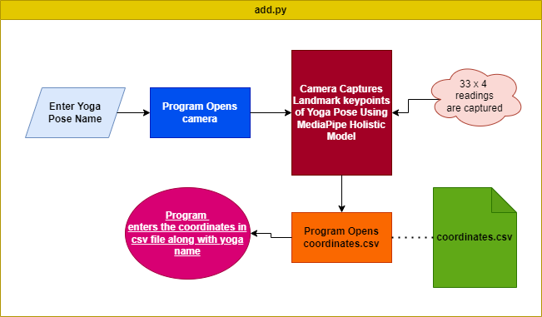
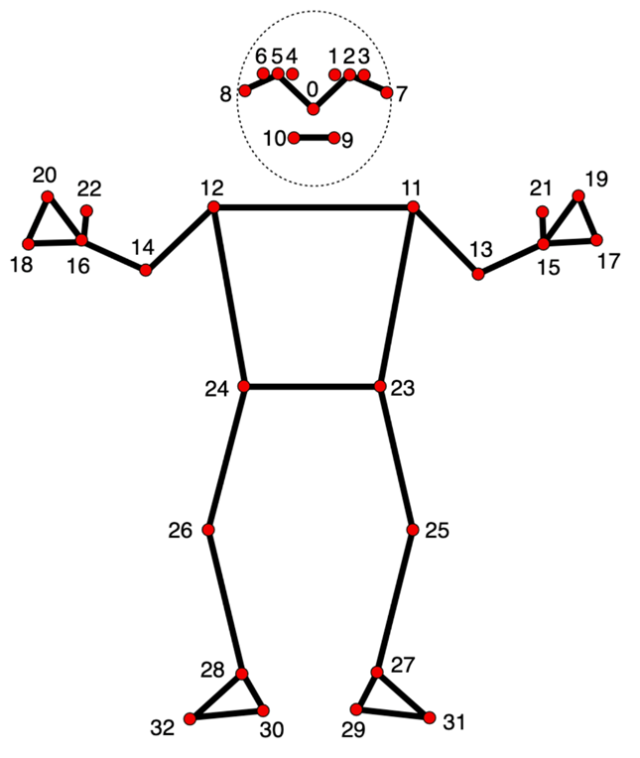
Camera opens for 10 seconds
1) Data Collection and its standardization
Data is collected using OpenCV and Mediapipe Holistics Model.
What I did was I first used OpenCV to use camera to take a live feed of Yoga Pose.
Then I used Mediapipe Holistics(Pose Landmarker) model in order to preprocess and capture 33 landmarks in 3D video frame, and stored them with their Yoga Pose Name as ,class_name,x1,y1,z1,v1,x2,y2,z2,v2,……x33,y33,z33,v33 and then I appended this data in coordinates .csv file.
After the collection of data, these data values differ and to standardize them we will use standard scaler in our pipelining.

Slide 6
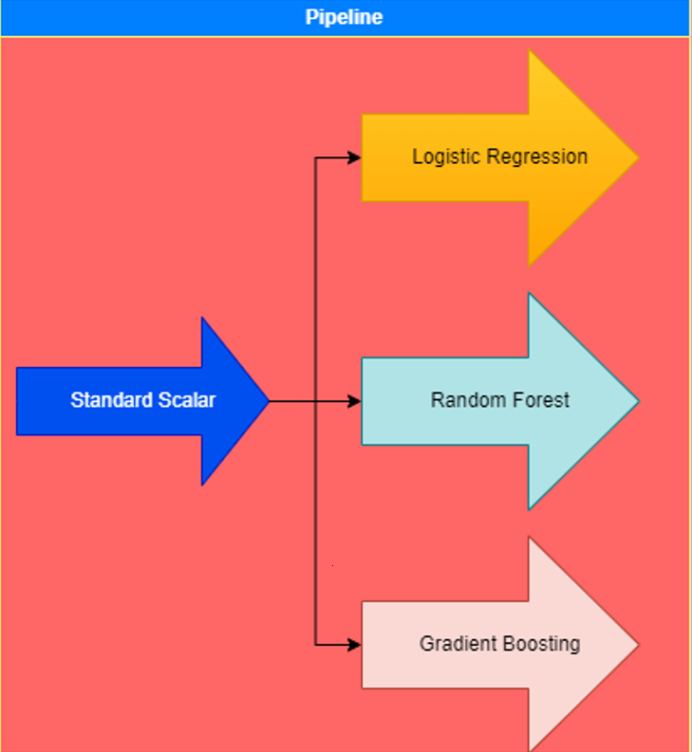
Data Splitting And Model Training
Features
Landmarks
Target
Class Labels
Data is split into training and testing data using scikit-learn train-test split.(Also these data are saved to be viewed later).
A pipeline is created to do standardization and training of data on 3 models for multi-class classification.
Standard Scaler is used to normalize our inputs and Logistic Regression Classifier,Random Forest Classifier and Gradient Boosting Classifier are used.
Best model is selected among all based on accurace(balanced dataset)
Saved as .pkl format

Slide 7
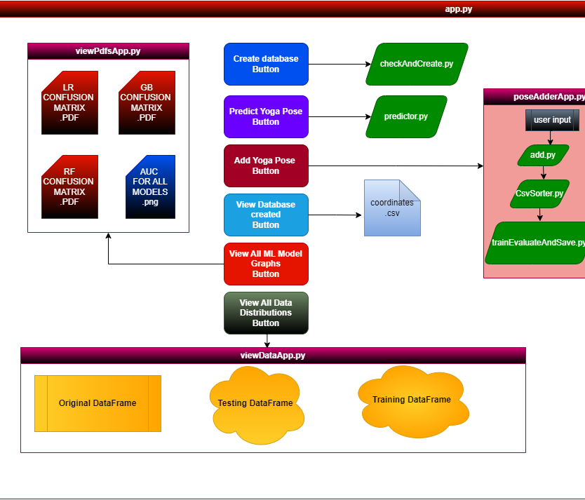
Front-End Creation
To create the back-end of this , I divided my program into multiple subscripts(used subprocess library).
To create front-end of this, I used Streamlit to create an interactive web-based front-end.
I created 3 app.py programs to open different pages and do different tasks for my program.

Slide 8
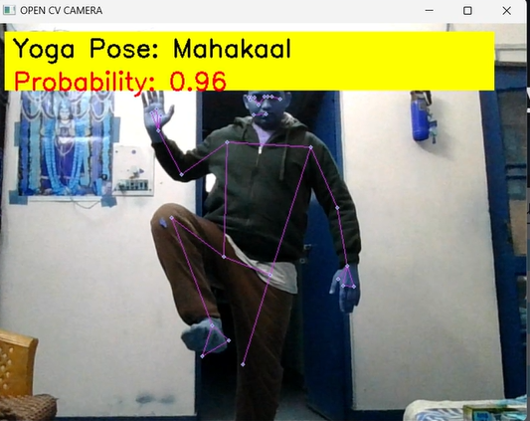
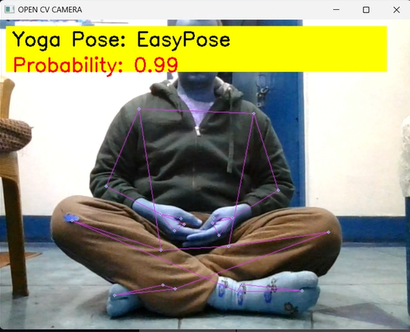
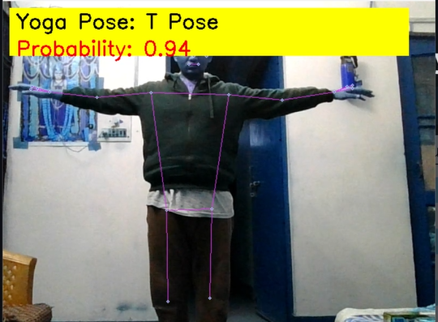
Predictions…
We are going to use OpenCV and MediaPipe Holistics again, in the same way, to process input pose on the Live Camera Feed.
We will then feed the input data and we will get the output labels(Yoga Pose) in our case, which will be displayed on the output screen( along with the accuracy of the pose being performed)

Slide 9
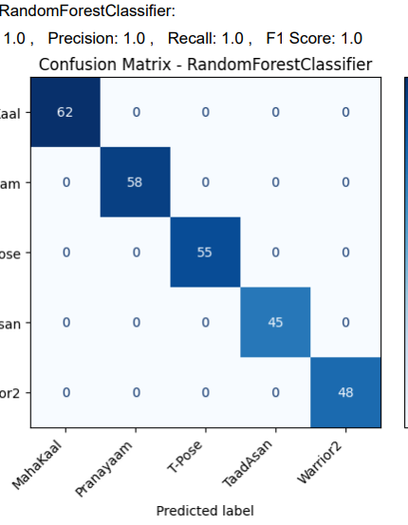
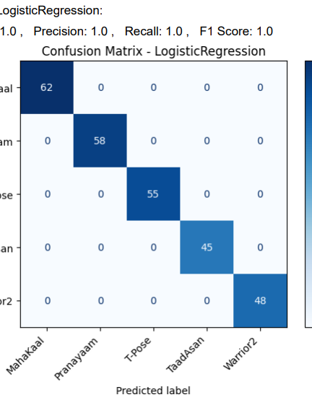
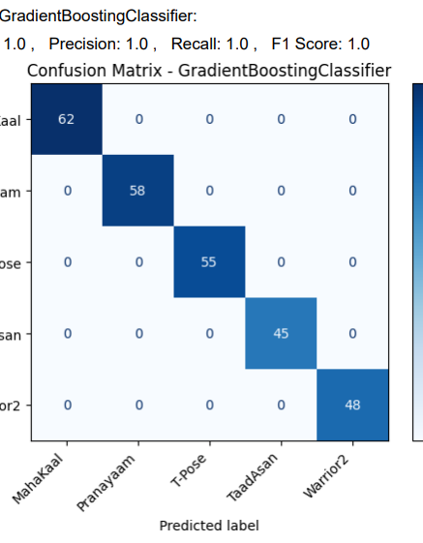
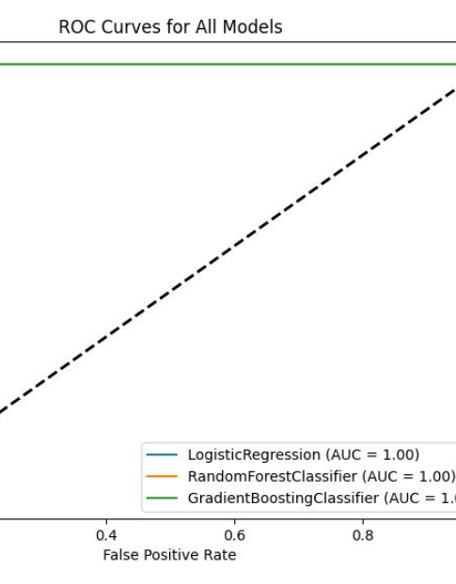
Model Evaluation
Best Model is selected and saved based on the accuracy score(Because my Dataset is Balanced).
Plots of Confusion Matrices for all 3 models along with their accuracy, precision, recall, and fβ score(where I selected β=1 because I wanted all the features to be considered important) in PDF formats.
In case my dataset becomes unbalanced, I have also saved an Area Under the Curve Plot for all models to check which is the best-performing model using the One vs. rest Classifier.

Slide 10
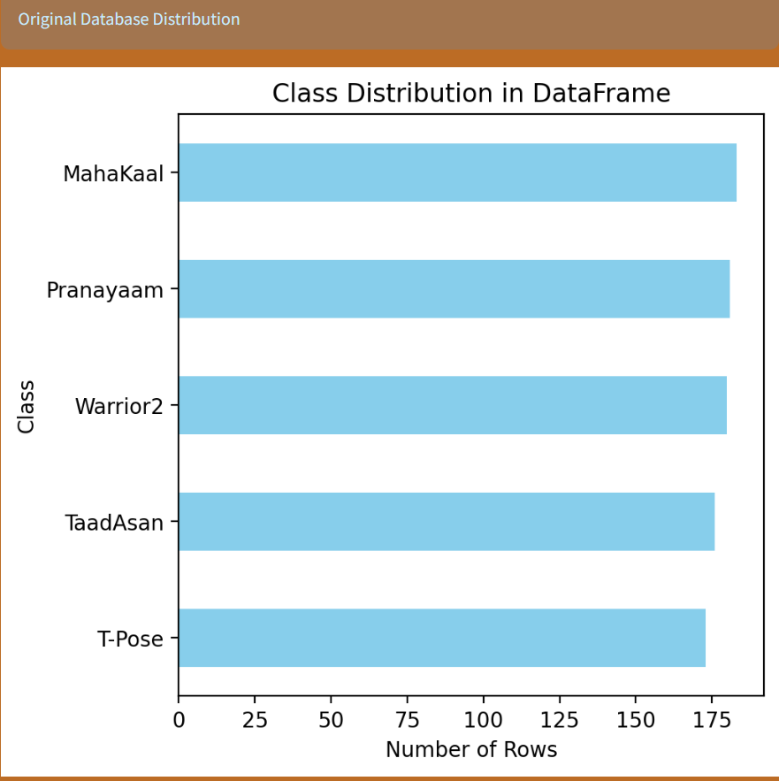
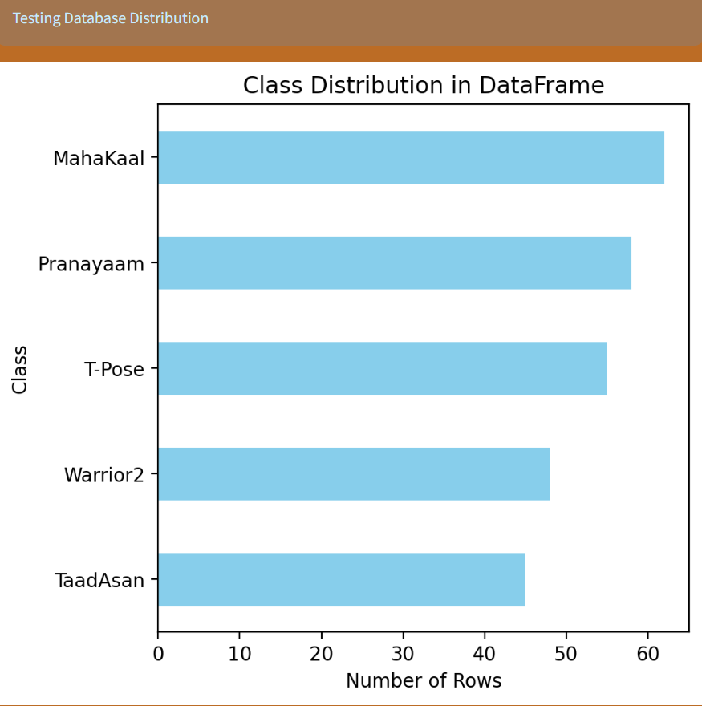
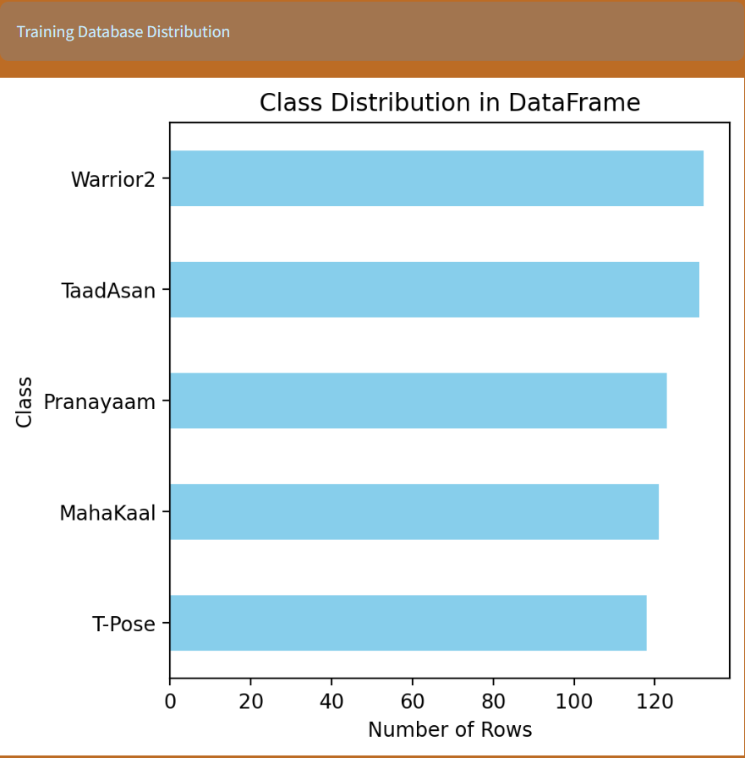
Data Visualization And Embedding all codes in the Front-End
After Splitting the dataset into training and testing data using sci-kit-learn train-test split, I saved that training and testing data in the same manner as it was in the original data frame, to look at the class distributions.
After doing all the codes and creating all the scripts, I created a front end of my application using the Python Streamlit library.
Original data
Testing data
Training data

Slide 11
Conclusion and Future Works
Future Works:
I intend to work on cross-platform support and make it more user-friendly.
I intend to create sets of specific Yoga Poses to be performed together for a well-balanced exercise and also add soundtracking for meditation purposes.
I also intend to add some security features, so that user data is secured.
I intend to learn more about Fire-Base to create individual track records and get good user feedback.
I would also like to collaborate with some professional yoga instructors and launch this application officially.
Conclusion: In this mini-project, I learned various ways to perform a Live Yoga Pose Classification. Also while trying this out, and training this model, I also went into the habit of doing Yoga myself.
I also learned about various ways of solving computer vision problems like object detection, landmark detection, etc.

Slide 12
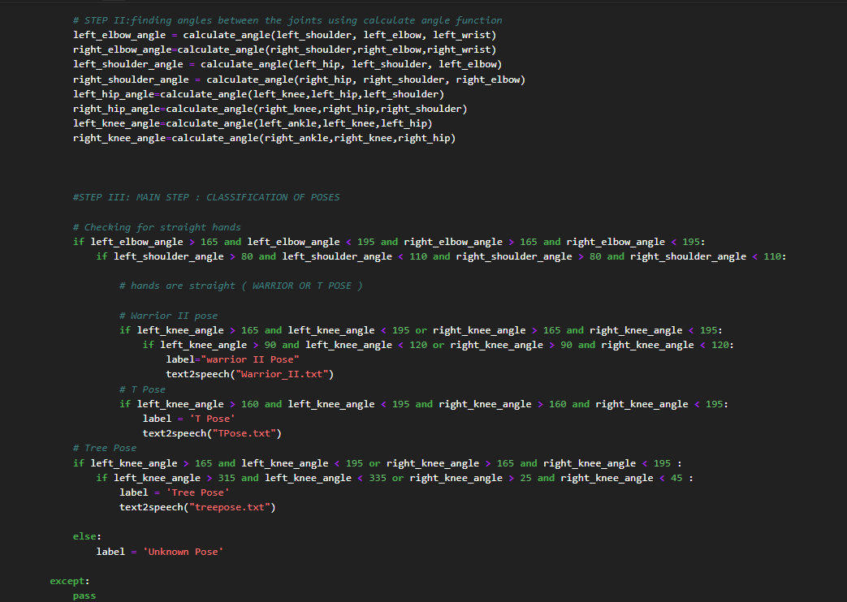
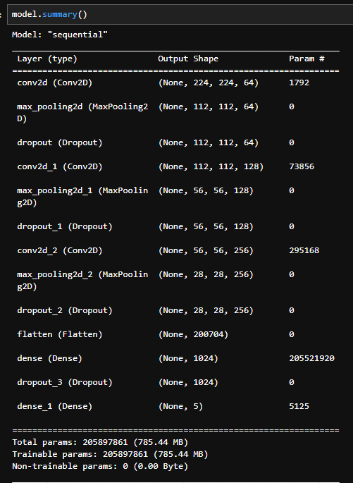
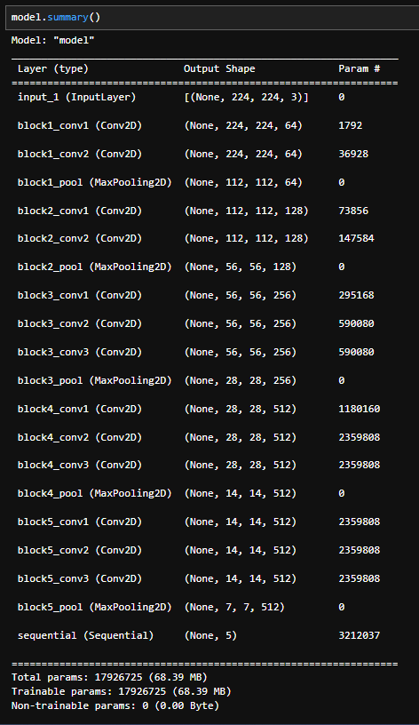
Results of previous Approaches…
Using MediaPipe and finding the joint angle
Custom CNN
CNN WITH VGG16

